Slide 1
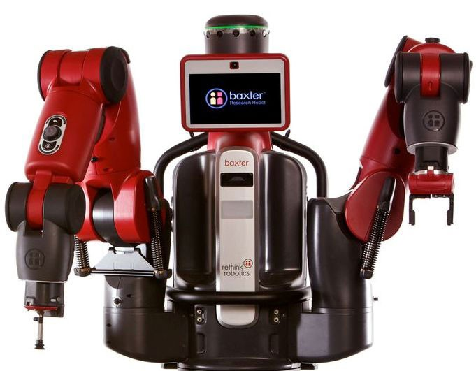
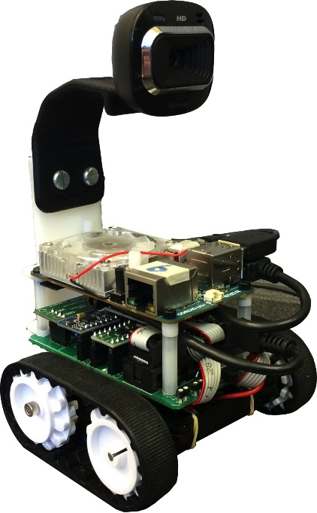
EE 106B/206B Robotic Manipulation and Interaction
Ruzena Bajcsy
Shankar Sastry
Spring 2019
GSIs:
Valmik Prabhu Chris Correa Nandita Iyer

Slide 2
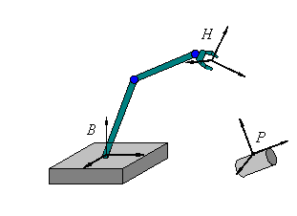
Preamble
Most slides in this course have benefited from:
notes from Zexiang Li and Yuanqing Wu, based on the textbook A Mathematical Introduction to Robotic Manipulation by R. Murray, Z. Li and S.S. Sastry (available online via bCourses).
The current version of these slides is by S.Sastry
R.Bajcsy, Jeff Mahler and K.Goldberg

Slide 3
Pererequisites
Students are expected to have taken EECS C106A / BioE C106A / EECS C206A, which should be sufficent preparation for all material in this class. A strong programming background, knowledge of Python and
Matlab, and some coursework in feedback controls (such as EE C128 / ME C134) are also useful. Stu- dents who have not taken EECS C106A / BioE C106A / EECS C206A should have a strong programming
background, knowledge of Python and Matlab, and exposure to upper division linear algebra, Lagrangian dynamics, mechatronics, and feedback controls.

Slide 4
The course is a sequel to EECS C106A/Bioengineering C106A and EECS C206A which covers kinematics, dynamics and control of a single robot. This course will cover dynamics and control of groups of robotic manipulators coordinating with each other and interacting with the environment including people. Concepts
will include an introduction to grasp modeling with friction, grasp planning. The course will also cover con- strained manipulation, perception guided manipulation, including concepts of holonomy and non-holonomy.
Throughout, we will emphasize design and human-robot interactions and applications in manufacturing, service robotics, and locomotion. We will also experiment with soft robots.
The lectures will be fast paced!!

Slide 5
Teaching Style
This course will be taught in a seminar style, with homework, four small projects/labs, and a final project. All submissions will go through Gradescope (Links to an external site.), which you all should have been added to. A piazza page (Links to an external site.) has been created for students to discuss homeworks and projects. Note that there will be no exams in this course. If you need disability-related accommodations in this class, if you have emergency medical information you wish to share with us, or if you need special arrangements in case the building must be evacuated, please inform us immediately. Please see the professor or GSIs privately after class or in the office.

Slide 6
The Syllabus
This syllabus is the foremost authority on course policies and deadlines. It should be
treated as a living document and will be updated throughout the semester. After the first two weeks
of the semester (during which policies may be slightly in flux), any updates to this document will be
accompanied by a bCourses announcement.
The hub for this class, and your source of all relevant files and resources, is the class’s bCourses
website.
Our primary method of official communication with you will be through bCourses announcements.
Make sure you are signed up to receive them by navigating to Account > Notifications and ensuring
that the check mark next to “Announcement” is green.
Your primary communication with us should be through Piazza, which can be accessed directly
through bCourses. Unless you have a reason to contact only a single course instructor, Piazza is the
best way to get a response within a reasonable time frame. Note that the framework supports private
“instructor-only” messages.

Slide 7
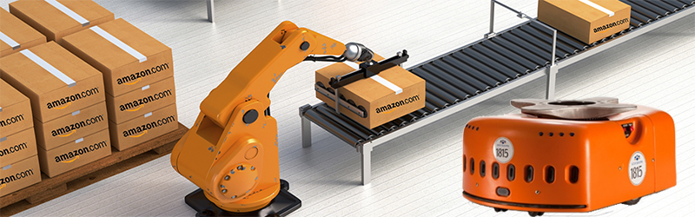
Course logistics
The course will have weekly lectures every Tuesday and Thursday from 11am-12:Pm.
The lectures will be shared by professors: Bajcsy, Sastry, postdoctoral fellow: Jeff Mahler and other faculty as they become available
The GSIs are: Valmik Prabhu and Chris Correa.The reader is Nandita Iyer
In addition there will every two weeks during January, February and March homeworks.

Slide 8
Questions regarding homeworks and labs should be directed to Valmik and Chris. Questions re- garding discussions and course logistics should be directed to Valmik. All questions can and should be directed to Piazza for the fastest response. When emailing a GSI, please prefix the subject line with [EE106B].
.
Role | Name | email | Office Hours
Professor | Ruzena Bajcsy | bajcsy@eecs.berkeley | TuTh 1:00-2:00pm 719 SDH
GSI | Valmik Prabhu | valmik@berkeley.edu | M 4-5; W 1-2 111 Cory
GSI | Chris Correa | chris.correa@berkeley.edu | TBD 111 Cory
Reader | Nandita Iyer | nandita@berkeley.edu | N/A

Slide 9
Disability accomodations
If you need disability-related accommodations in this class, if you have emergency medical information you wish to share with us, or if you need special arrangements in case the building must be evacuated, please inform us immediately. Please see the professor or GSIs privately after class or send us an email.

Slide 10
Homework Assiganments and evaluation
Homeworks will b by using be collected and graded using Gradescope.com system.Create an Account on Gradescope.com with your Berkeley email account and SID. Add this code TODCollaboration on homework sets is encouraged, but all students must write up their own solution set. Additionally, every student is accountable for the solutions they submit and may be asked to discuss them with a GSI or instructor. Please list all collaborators at the top of each submitted homework set.

Slide 11
There will be 5 Homework assignments
Assignment | Posted Date | Due Date
HW 1 | 01/25/19 | 02/03/19
HW 2 | 02/03/19 | 02/17/19
HW 3 | 02/18/19 | 03/03/19
HW 4 | 03/04/19 | 03/17/19
HW 5 | 03/18/19 | 04/06/19

Slide 12
Questions on Homeworks
Questions regarding homeworks and labs should be directed to Valmik and Chris. Questions re- garding discussions and course logistics should be directed to Valmik. All questions can and should be directed to Piazza for the fastest response. When emailing a GSI, please prefix the subject line with [EE106B].

Slide 13
The Labs
The lab in 111 Cory is open for use for the labs/mini-projects and the final project. Please do not use the hardware until the discussion on lab safety, which will occur on TODO. The robots/hardware will be shared. Please reserve times on the following calendars:
There are no official lab sections or checkoffs, as there are in 106A. Instead, students will work on their own time and turn in a lab report to Gradescope. Labs should be completed in groups of 2-3.
Robot Baxter/Sawyer
Calendar TODO
TODO
Turtlebot
(Links to an external site.)Links to an external site.TODO

Slide 14
Final Project
The final project will constitute the largest single portion of your grade for this course and must in- clude sensing, planning, and actuation components on real hardware. Whereas the 106A project was an
implementation-based project, this project should be research-based. Project deliverables include a pro- posal, a live demo and poster session, an academic-style paper, a small website, and several intermediate
check-ins. Further information will be forthcoming; in the meantime, feel free to explore the list of previous projects available on bCourses! Due to the types of deliverables involved (e.g., live demonstrations)
Late work will not be accepted.

Slide 15
Office Hours
The instructors will hold weekly office hours to discuss lecture content, homework assignments, projects, and other course material. We will try our best to schedule them so that each student has the opportunity to attend at least one office hour each week. When discussing a current homework assignment, instructors will not provide solutions. Rather, instructors will be happy to help clarify fundamentals and to guide students’ reasoning in related problems.

Slide 16
Note on Late work
While we will abide by the policies listed above regarding specific assignment types, we understand that unforeseen circumstances do happen. If you feel that you will not be able to complete an assignment on time under the policies listed above due to truly extenuating circumstances, please inform a course instructor as soon as possible and before the associated deadline to discuss your situation. Once the deadline has passed, accommodations are unlikely.

Slide 17
Regrade request
If you feel that your work has been graded unfairly, you may request a regrade by submitting a request on Gradescope with a written statement explaining the mistake. Be aware that points may be deducted as well as added if a regrade is requested.

Slide 18
Lectures
Lecture LEC 001 T/Th 11a-12:30p Ruzena Bajcsy 521 Cory Discussion DIS 201 M/W 2-3p Valmik Prabhu 111 Cory DIS 202 M/W 3-4p Valmik Prabhu 111 Cory

Slide 19
Lecture plans
Review: 1 weekControls and Trajectory Tracking: 2 weeks
Grasping: 2 weeks
Differential Geometry and Nonholonomy: 2.5 weeks
Hyper redundant and soft robots: 2.5 weeks
Path planning: 1 week
Special Topics: 3 weeks

Slide 20
Final Project guidelines
Projects are expected to apply multiple aspects of what you have learned
Every project should include some sensing, planning and manipulation.
Demonstrate good designer/experimentalist rigor:
What did you measure, what are your assumptions, what did you compute from the measurements?
How did you evaluate your results (systematic errors, random errors)?
Lessons learned. What should be the next steps?
See course syllabus for details on project requirements.

Slide 21
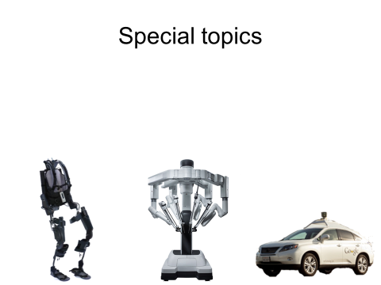
Special Topics

Slide 22

Questions,comments

